Slide 1
Neural Radiance Field with Refraction
Zhangkaiwen Chu
ROBO MSE
chuzhkw@seas.upenn.edu

Slide 2
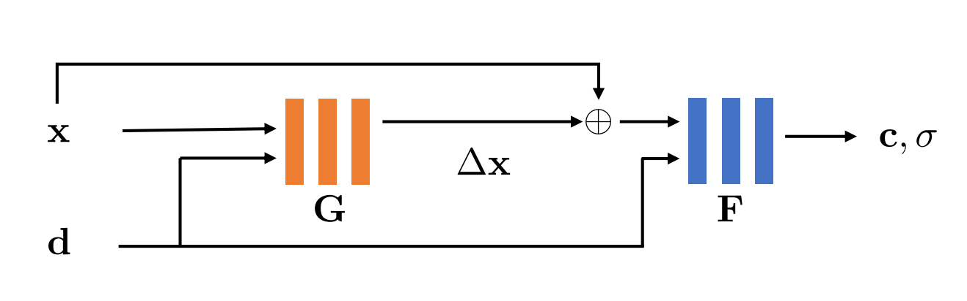
Overview
Neural Radiance Field assumes light travels in a straight line, so it is bad at learning specular and refractive effect.
LB-NeRF use a neural network to learn an offset field to model the light bending.

Slide 3
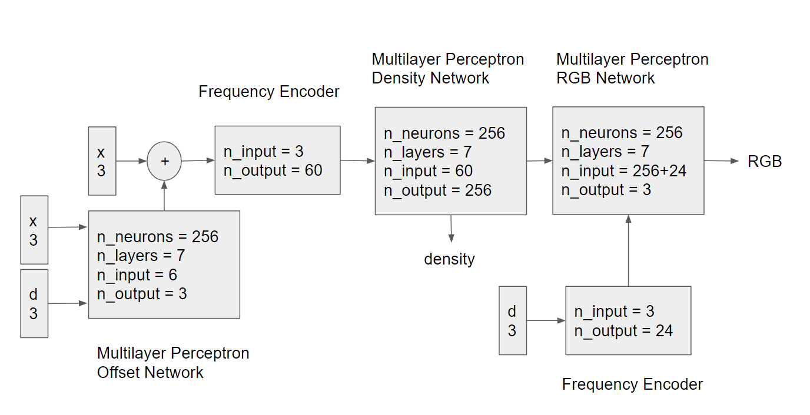
Network Architecture

Slide 4
Training
Input of position is normalized, range from -1 to 1
Position is still small without normalization
Offset field can predict offsets like 10 or 100, totally mess up the training
Tanh activation restricts the offset in [-1, 1]
Tanh makes the training harder, offset field becomes all zeros
Conditionally regularize the offset
Use L1 regularization to create sparse offset field

Slide 5
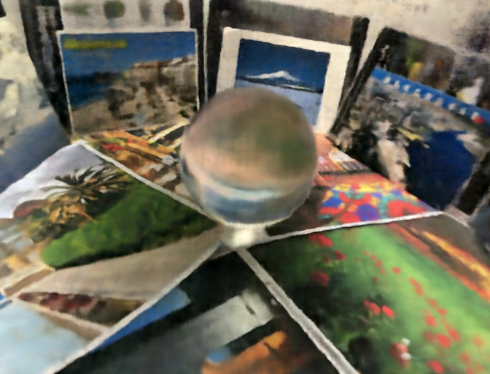
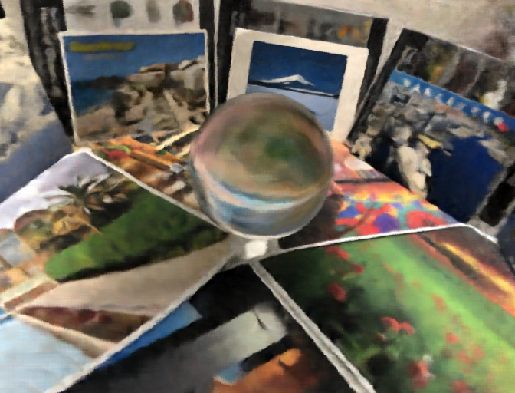
Results
NeRF
LB-NeRF

Slide 6

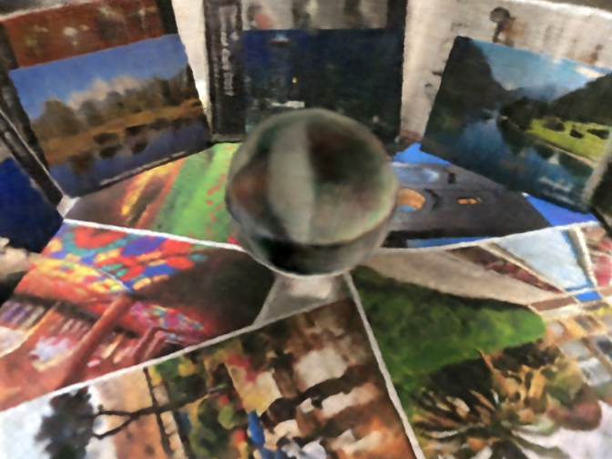
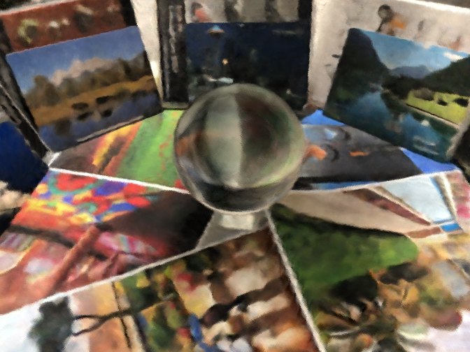

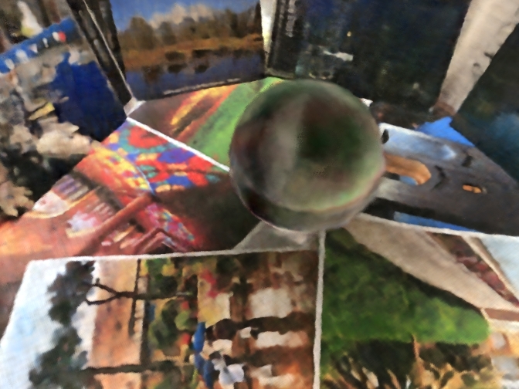
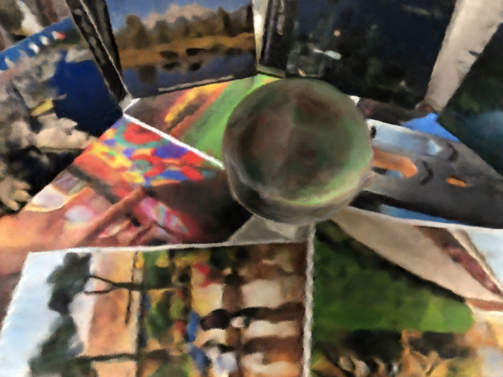
Results
reference
NeRF
LB-NeRF

Slide 7
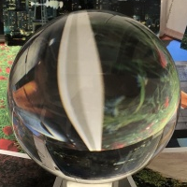
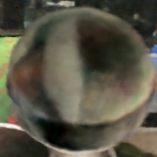
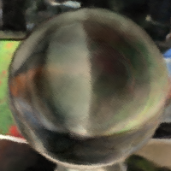
Results - Pros
reference
NeRF
LB-NeRF
MS-SSIM = 1
MS-SSIM = 0.5163
MS-SSIM = 0.5908
MS-SSIM: Multi-scale Structural Similarity

Slide 8

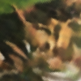
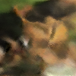
Results - Cons
reference
NeRF
LB-NeRF
MS-SSIM = 1
MS-SSIM = 0.6298
MS-SSIM = 0.5537
MS-SSIM: Multi-scale Structural Similarity

Slide 9
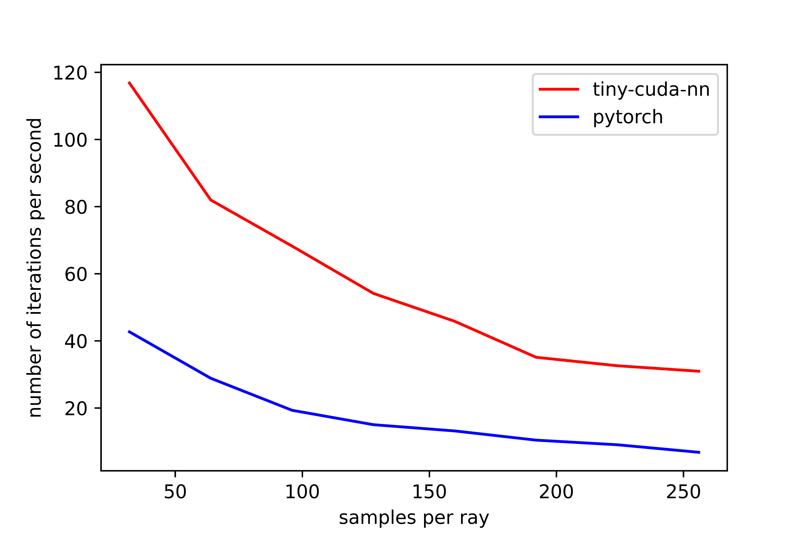
Runtime Performance

Slide 10
Acknowledgement
Thanks for my shadow team of their great suggestions.
instant-ngp
https://github.com/NVlabs/instant-ngp
LB-NeRF
https://ieeexplore.ieee.org/document/9897642
tiny-cuda-nn
https://github.com/NVlabs/tiny-cuda-nn
pytorch-nerf
https://github.com/yenchenlin/nerf-pytorch

